Slide 1
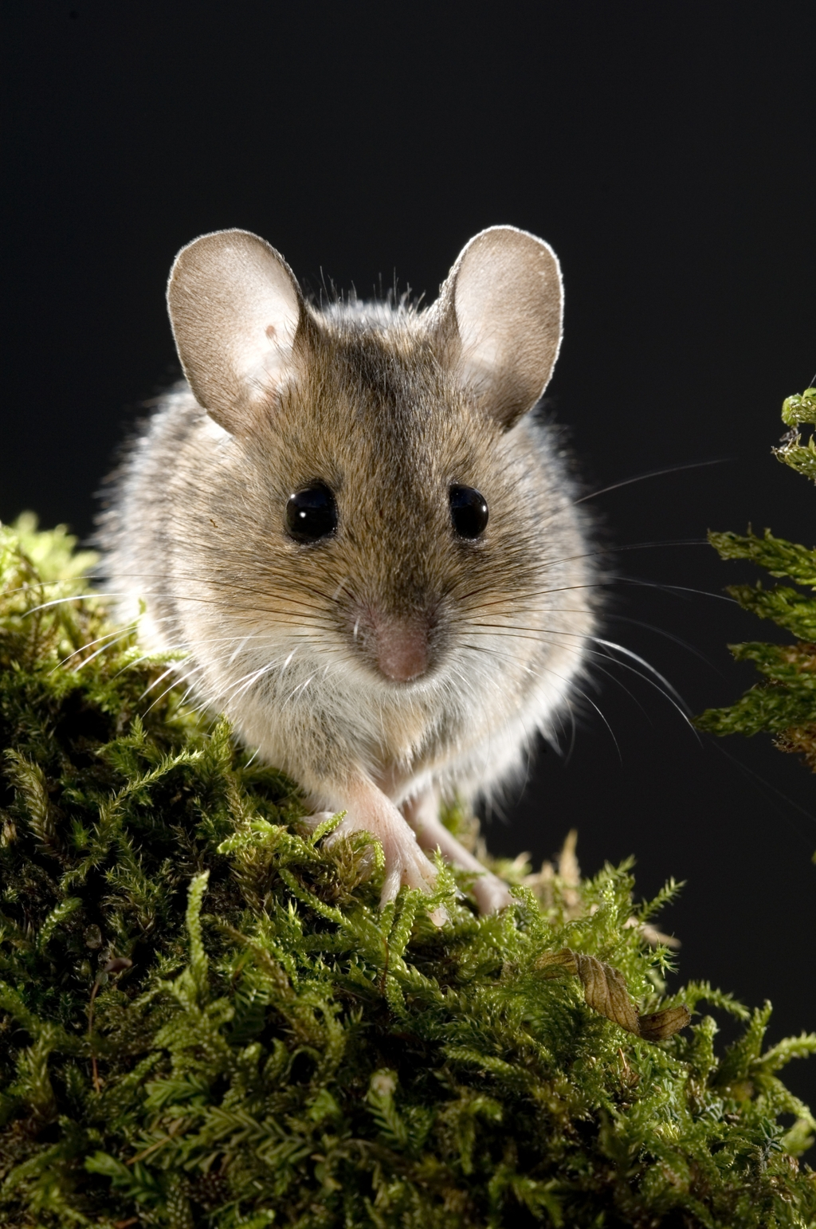
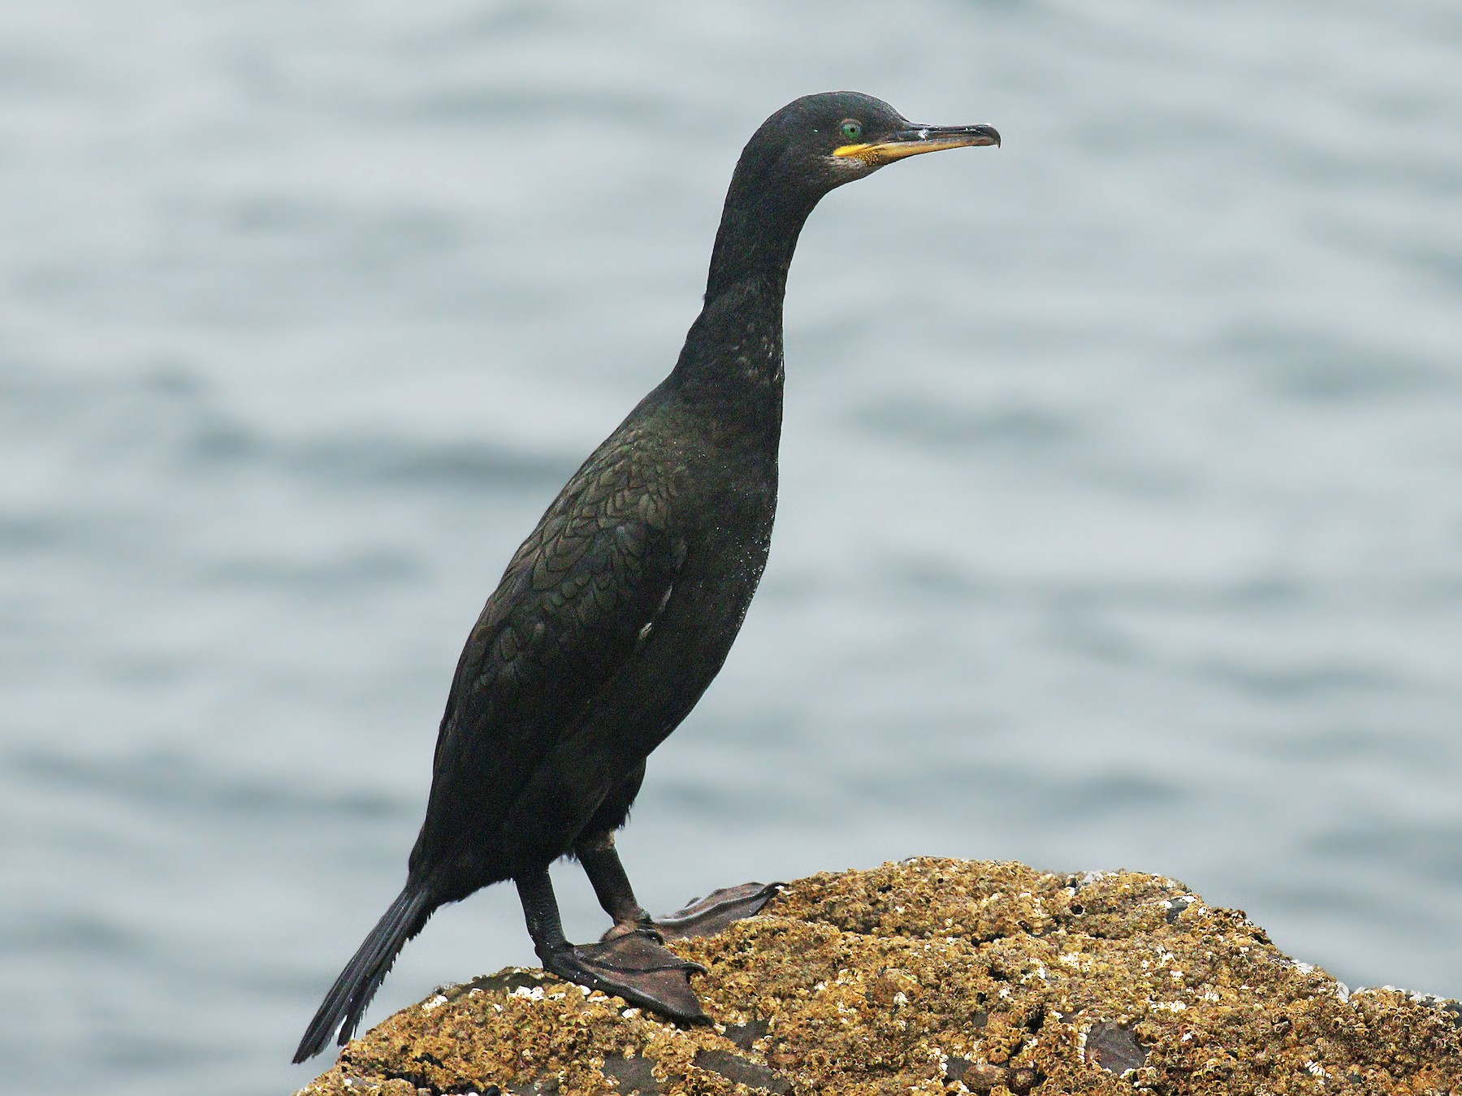
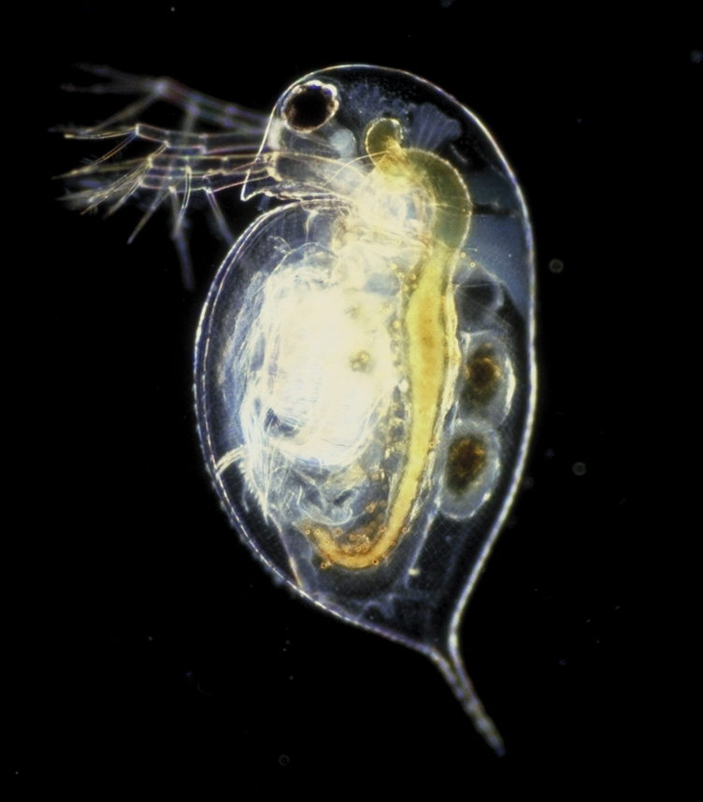
Ageing Wild Animals with the Minion
Tom Little, Aine O’Toole
Wood Mouse
European shag
Daphnia
How old are each of these animals?
What causes some individuals to age faster than others?
H
H
C
H
Epigenetic Clocks for Wild Animals
To develop and deploy biomarkers of age for wild animals
http://littlelab.bio.ed.ac.uk
Notes:
I am presenting at Ion bru because I think we are making somewhat novel use, in terms of the area-ageing –and technique, of the Minion that the audience here might find interesting

Slide 2
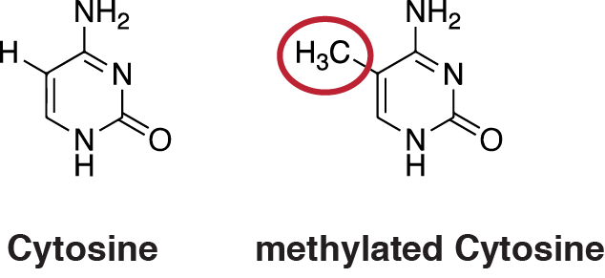
Methylation-based biomarkers of age
C_{p}G
C_{p}G
C_{p}G
C_{p}G
ATGCGGTAAGTCAGTCGCGCCGGTAATTTAACGGGTCACGCCCGAATTGCTAC

Slide 3


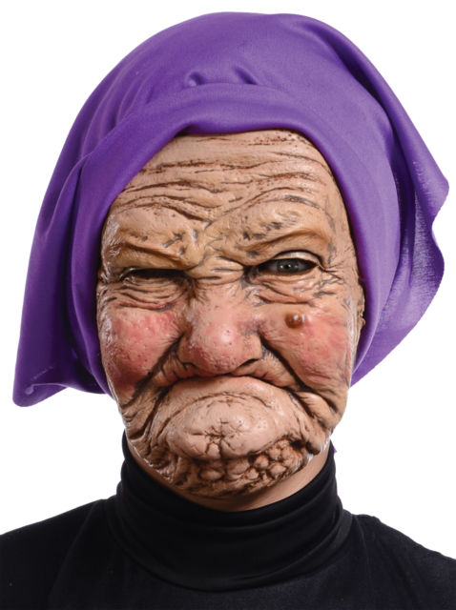
ATGCGGTAAGTCAGTCGCGCCGGTAATTTAACGGGTCACGCCCGAATTGCTACGGTCAAATTCGCGGATGCA
ATGCGGTAAGTCAGTCGCGCCGGTAATTTAACGGGTCACGCCCGAATTGCTACGGTCAAATTCGCGGATGCA
ATGCGGTAAGTCAGTCGCGCCGGTAATTTAACGGGTCACGCCCGAATTGCTACGGTCAAATTCGCGGATGCA
ATGCGGTAAGTCAGTCGCGCCGGTAATTTAACGGGTCACGCCCGAATTGCTACGGTCAAATTCGCGGATGCA
ATGCGGTAAGTCAGTCGCGCCGGTAATTTAACGGGTCACGCCCGAATTGCTACGGTCAAATTCGCGGATGCA
ATGCGGTAAGTCAGTCGCGCCGGTAATTTAACGGGTCACGCCCGAATTGCTACGGTCAAATTCGCGGATGCA
ATGCGGTAAGTCAGTCGCGCCGGTAATTTAACGGGTCACGCCCGAATTGCTACGGTCAAATTCGCGGATGCA
ATGCGGTAAGTCAGTCGCGCCGGTAATTTAACGGGTCACGCCCGAATTGCTACGGTCAAATTCGCGGATGCA
ATGCGGTAAGTCAGTCGCGCCGGTAATTTAACGGGTCACGCCCGAATTGCTACGGTCAAATTCGCGGATGCA
ATGCGGTAAGTCAGTCGCGCCGGTAATTTAACGGGTCACGCCCGAATTGCTACGGTCAAATTCGCGGATGCA
ATGCGGTAAGTCAGTCGCGCCGGTAATTTAACGGGTCACGCCCGAATTGCTACGGTCAAATTCGCGGATGCA
ATGCGGTAAGTCAGTCGCGCCGGTAATTTAACGGGTCACGCCCGAATTGCTACGGTCAAATTCGCGGATGCA
ATGCGGTAAGTCAGTCGCGCCGGTAATTTAACGGGTCACGCCCGAATTGCTACGGTCAAATTCGCGGATGCA
ATGCGGTAAGTCAGTCGCGCCGGTAATTTAACGGGTCACGCCCGAATTGCTACGGTCAAATTCGCGGATGCA
ATGCGGTAAGTCAGTCGCGCCGGTAATTTAACGGGTCACGCCCGAATTGCTACGGTCAAATTCGCGGATGCA

Slide 4
% change methylation is proportional to change in age
Age acceleration
%methylation
[Epigenetic Age]
Humans +/- a few years
Mice +/- 3 weeks
Age deceleration
Chronological Age
These epigenetic clocks seem to also estimate age acceleration; and this predicts all-cause mortality
Age acceleration is associated with lifestyle factors, infection [stress factors]

Slide 5
% change methylation is proportional to change in age
[at some CpGs]
How do you identify informative CpGs? Two steps:
Detect methylation
Nanopore sequencing can detect methylated Cs (not something I have done yet)
Sequence bisulphite treated DNA (because any unmethylated C is converted to U)
(2) Identify CpGs that are correlated with age
If working on a new organisms, you will need a whole genome approach
Or…

Slide 6
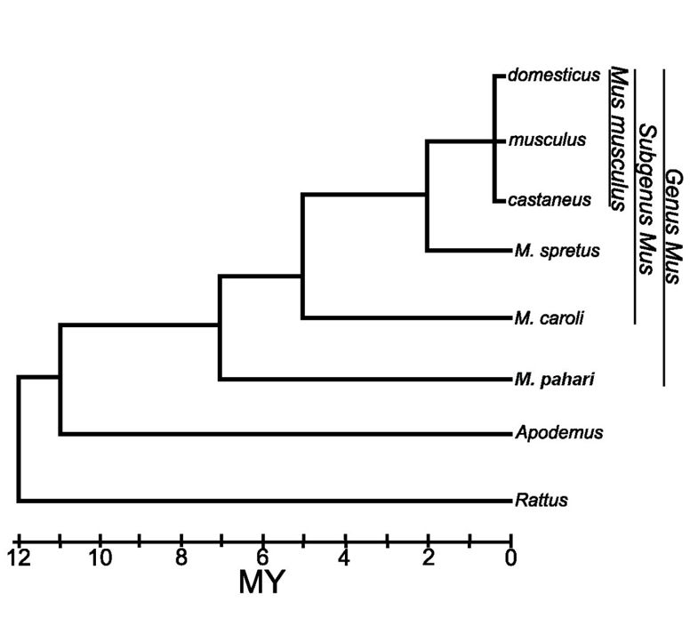
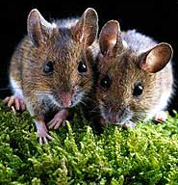
If informative CpGs have been identified in a closely related animal, you might successfully study the same (or nearby) CpGs via PCR

Slide 7
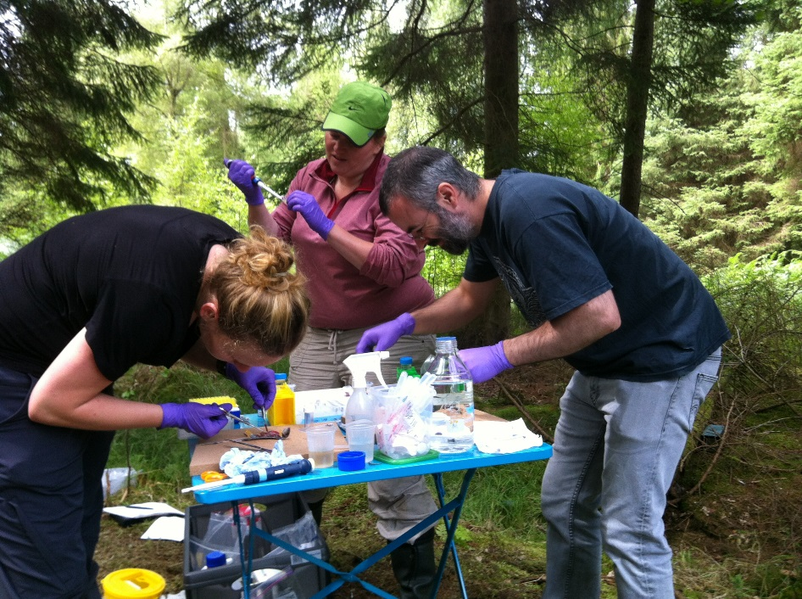
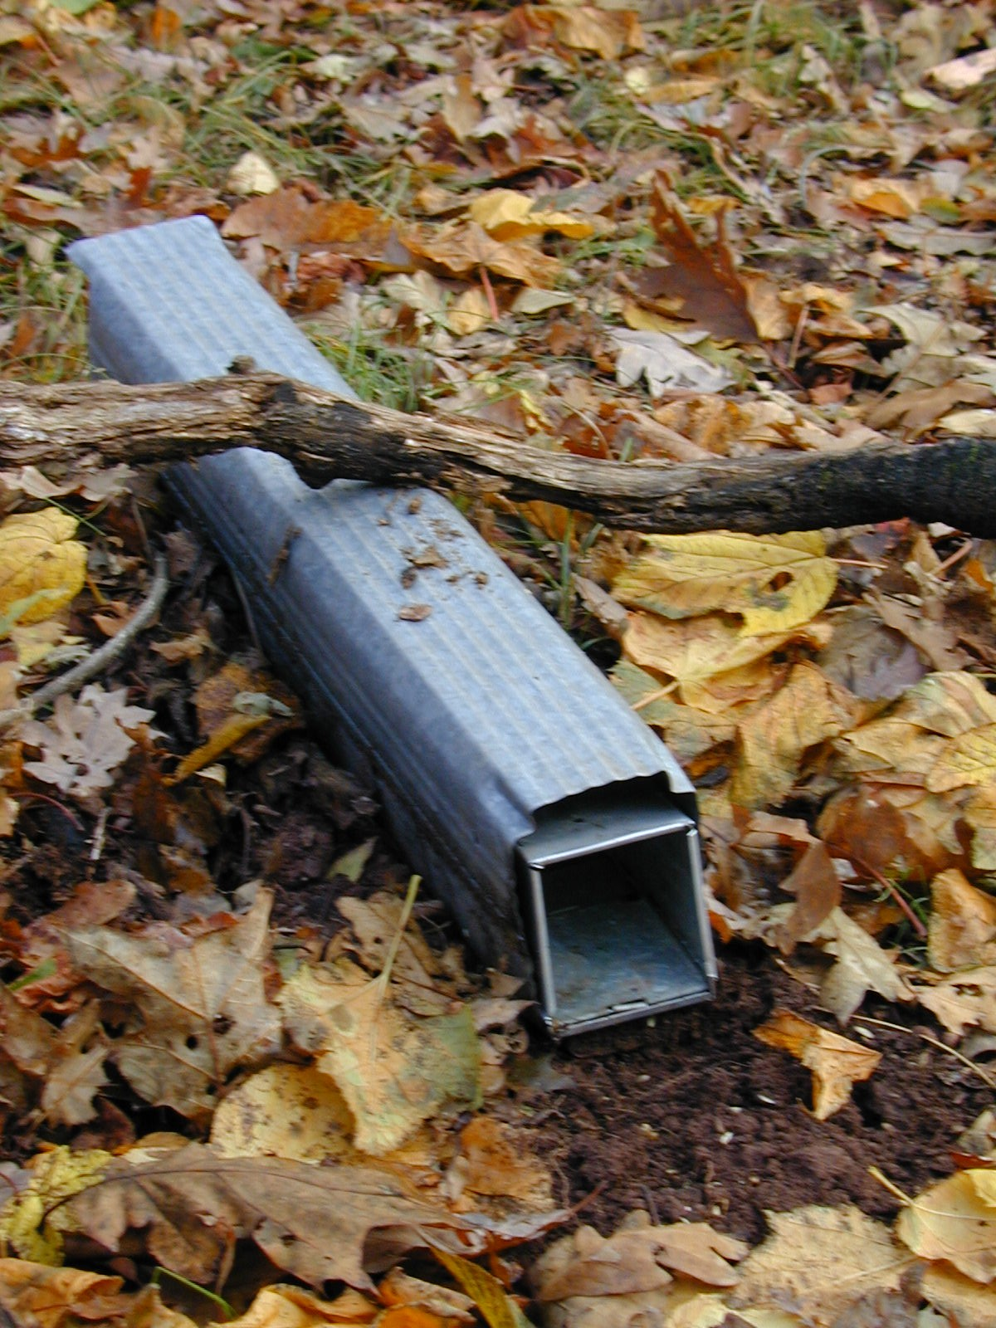
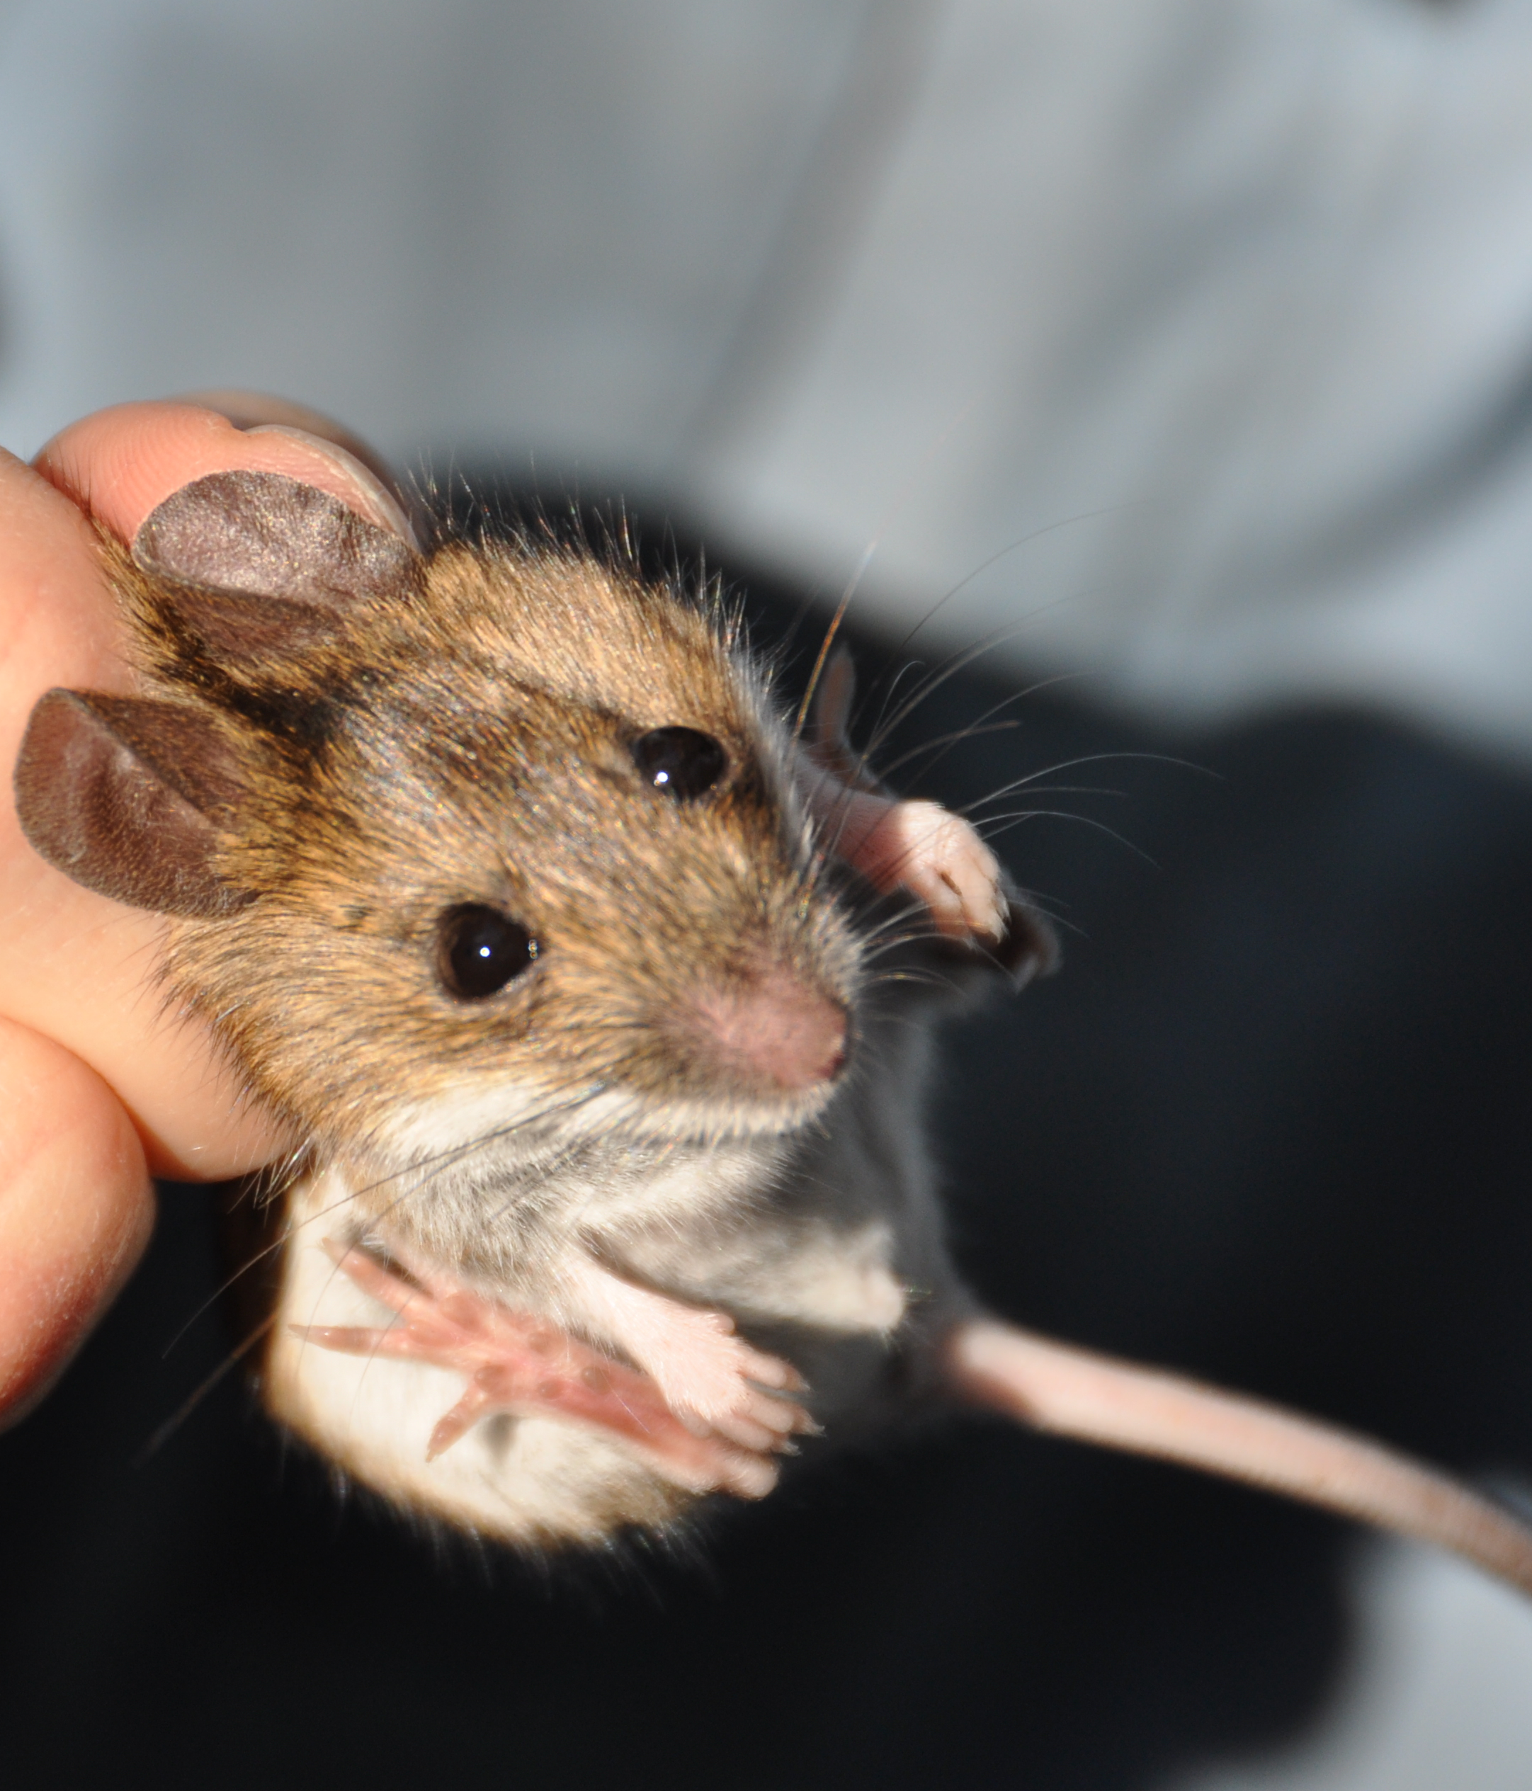

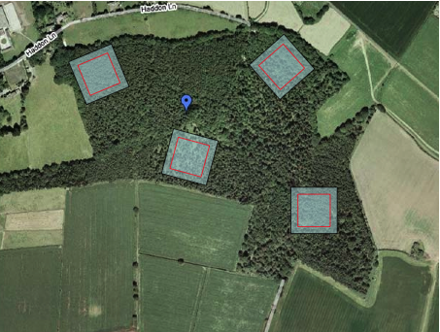
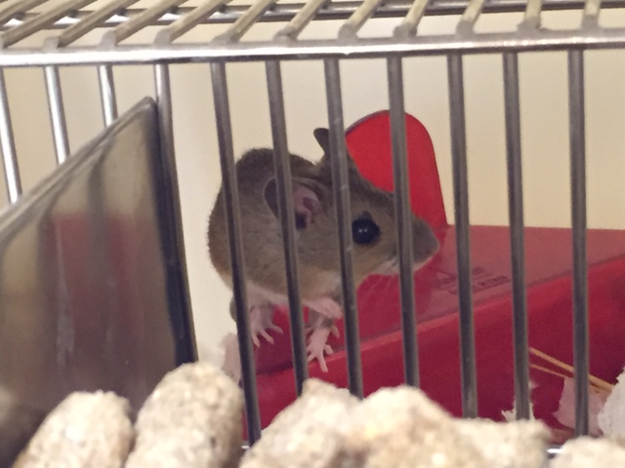
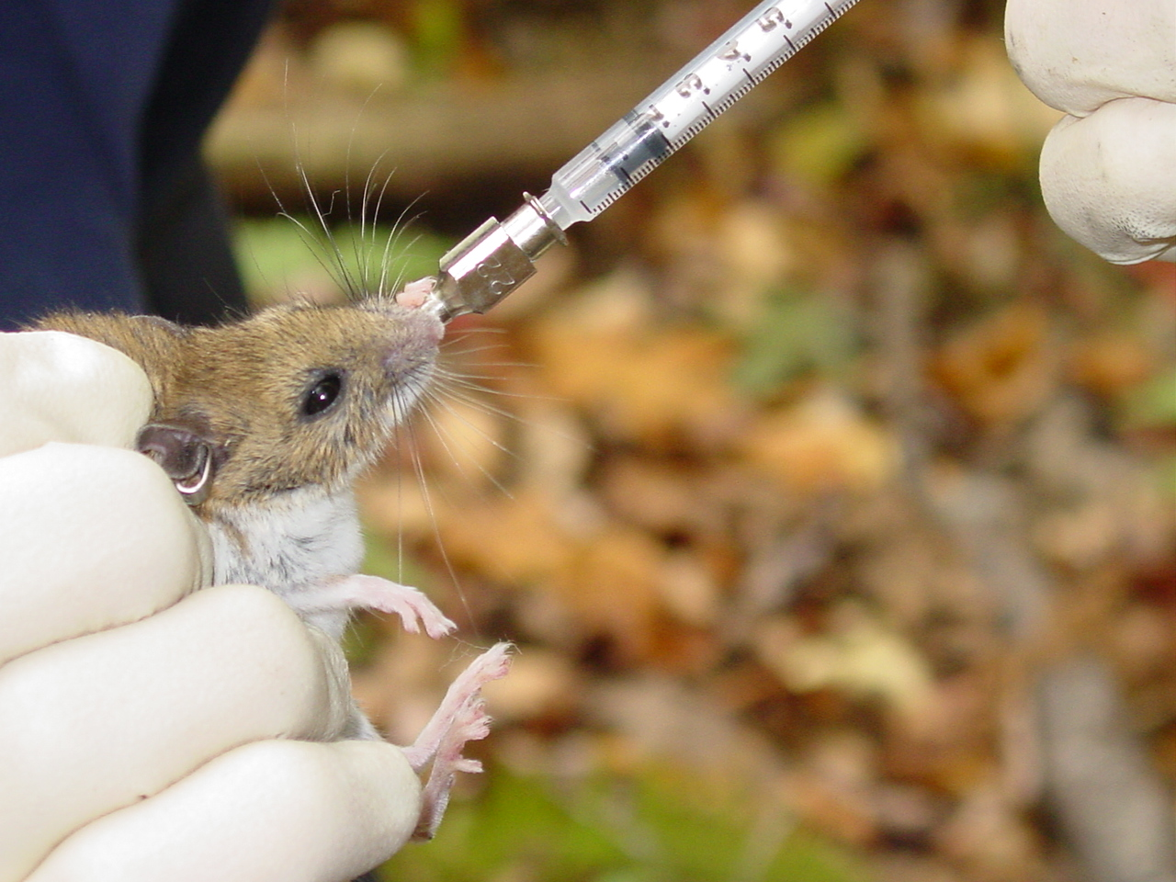
The critical benefits of using a wild mouse model include the ability to:
A wild system with >30 naturally infecting parasites, social interactions, seasonality, neighbours, reproducton, immune responses and nutritional status
Conduct placebo-controlled treatment trials (in the wild and in a controlled colony, varying in, for example, anti-parasitic drugs or nutritional supplementation) that are not feasible in human studies
conduct longitudinal sampling of hundreds of mice; across whole lifespans, incl before and after treatment
Field sites: Scotland

Slide 8

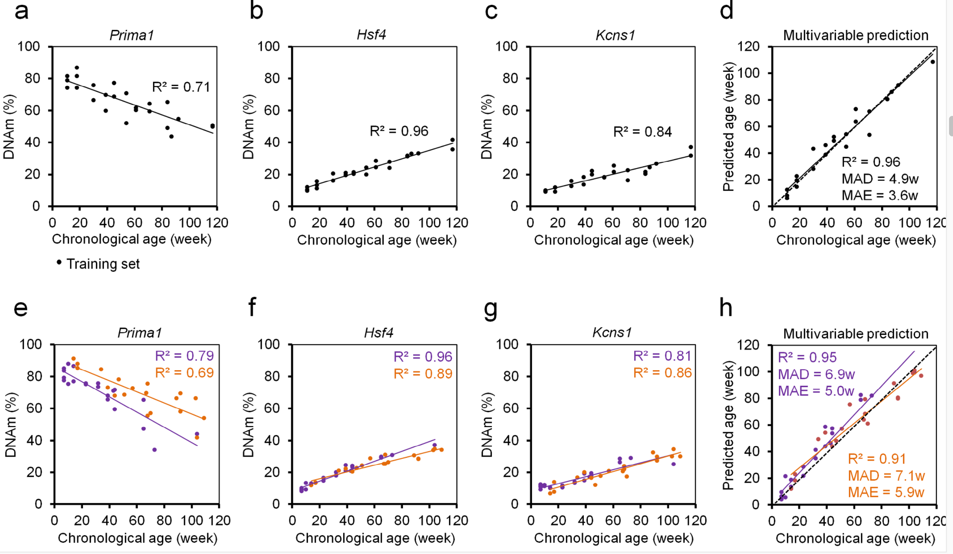
I made an epigenetic clock with targeted (PCR-based) bisulphite sequencing on genes known to contain clock-like CpGs

Slide 9
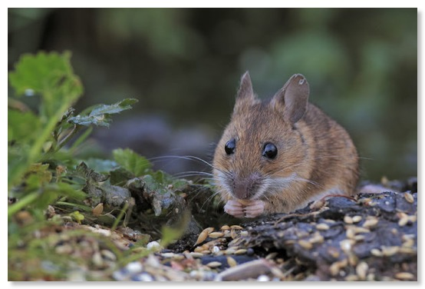
How to Train Your Epigenetic Clock
Four colony mice at each of five ages: 14, 21 weeks, 35, 39 and 44 weeks
Ear Punch

Slide 10
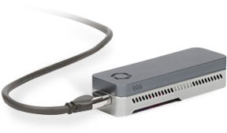

Mouse to sequence
DNA extraction
BS Treatment
PCR[5 genes]
Mix genes
Barcode mice
Flongle
Bioinformatics to informative CPGs
Bin reads [by barcode, BLASTn to refs]
Est %meth at 75CpG[Nanopolish]
Find age predictors [penalised regression, Lasso, ‘leave one out’]
6 X 24 = £420+£470+£87=£6.78 per mouse per tissue for ONP items, + BS, TAQ, primers etc, ~£10 per mouse.
https://github.com/aineniamh/aging-mice

Slide 11
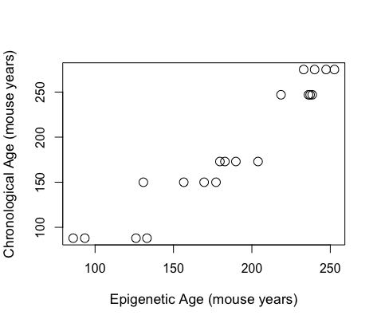
LASSO penalized regression identified 10 informative CpGs with a correlation coefficient to age of 0.95 (left).
Using the 10 CpGs in a regression, The Root Mean Square Error is 23, meaning we can identify mouse age to within 23 days (right).

Slide 12
Thanks
Amy P (Apodemus system, questions, field design)
Ricardo Marioni (CMVM, penalised regression specialist)
Tamir Chandra (CMVM, bisulphite seq specialist)
Andrew Rambaut (Minion operations)
Josh Quick (Sequencing advice)
Jess, Amy, Saudamini[AP] for samples and support
H
H
C
H
Epigenetic Clocks for All!

